Slide 1
CULTURE & SOCIETY
By
UZMA ALEEM

Slide 2
YOUR OPINION MATTERS A LOT
YOU Tell me?

Slide 3
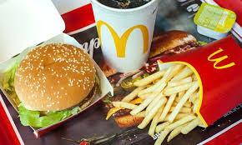
What comes in your Mind???

Slide 4
FOOD

Slide 5
Ever Heard about McDONALDISATION??

Slide 6
GUESS THE FAITH?

Slide 7
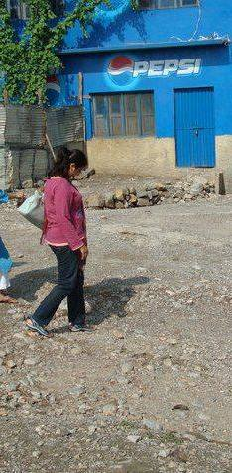
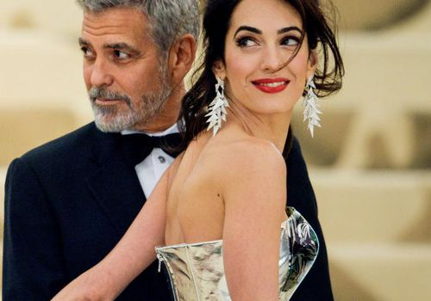

Slide 8
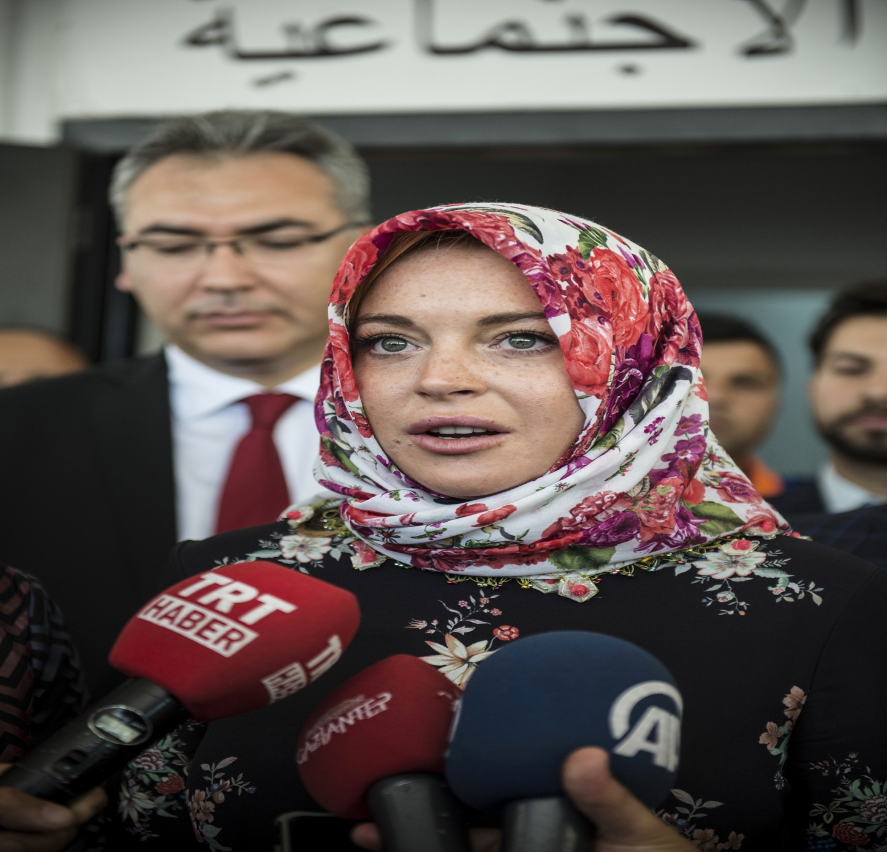

Slide 9
Prominent Religions of the world

Slide 10
Festivals, Customs, celebrations… we all know what it is…

Slide 11
Art & Architecture

Slide 13
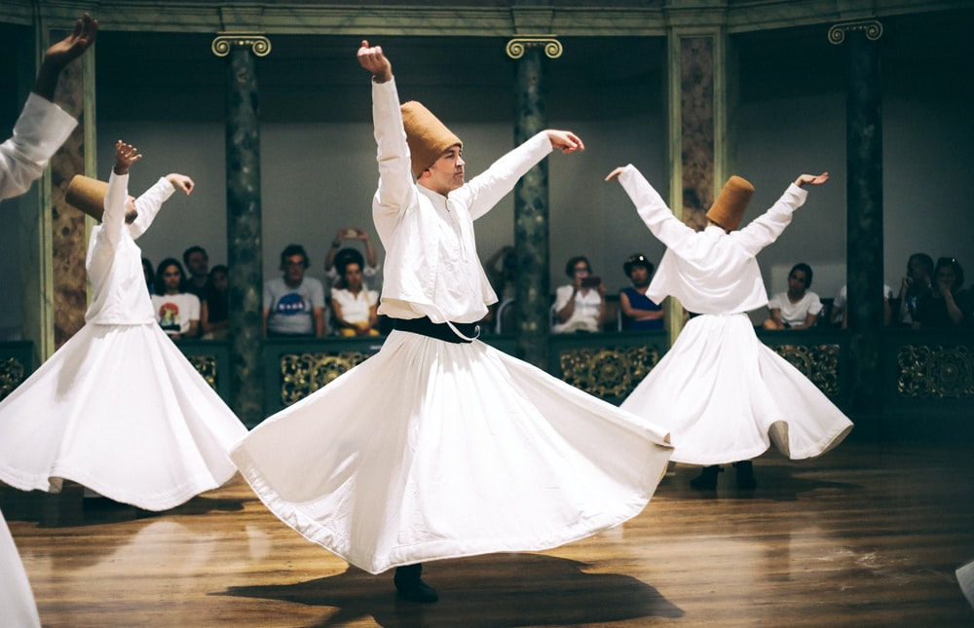
Communication: Music, Dance, Language

Slide 14
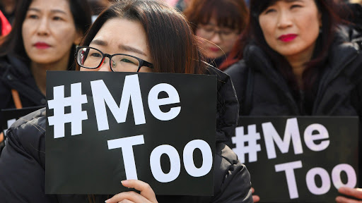
Communication Channel- TWITTER

Slide 15
Economy (Consumerism)

Slide 16
Sports

Slide 17
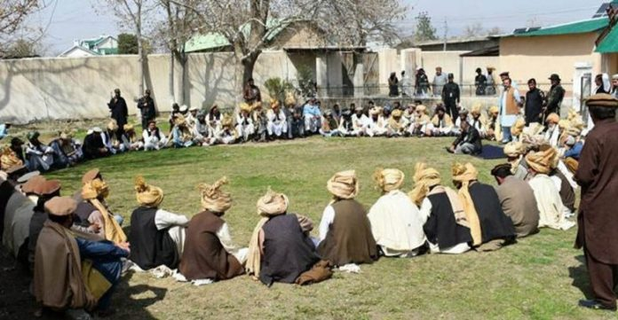
Politics (Parallel administrative & judicial system????)

Slide 18
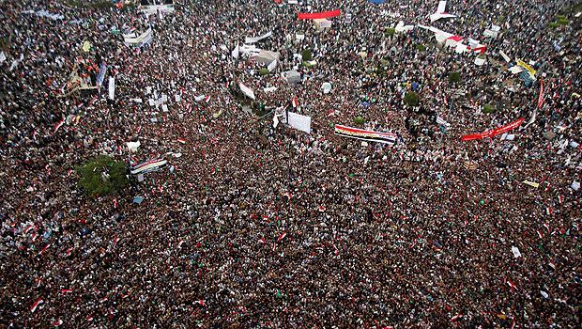
ARAB SPRING AlTehreer Square- Twitter & FB

Slide 19
Elements of Culture
Religion: Beliefs of a society, some traditions
Art: Architecture, style
Politics: Government and laws of a culture (rules and leadership)
Language & Communication: Communication system of a culture (speech, writing, symbols)
Economy : How people get the things the need (trade, agriculture, industry, money, hunting)
Customs: Traditions of a culture (holidays, clothing, celebration)
Society: Types of people in a culture (race, nationality, religious identity)
Geography: The land, location, and natural resources of a culture (physical features, climate, raw materials)

Slide 20
CULTURE
Culture: People of the same society share aspects of their culture, such as language or beliefs. Culture refers to the language, values, beliefs, behavior, and material objects that constitute a people’s way of life. It is a defining element of society.Example: Some features of American culture are the English language, a democratic system of government, cuisine (such as hamburgers and corn on the cob), and a belief in individualism and freedom.

Slide 21
Society
According to sociologists, a Society is a group of people with common territory, interaction, and culture.
Social Groups consist of two or more people who interact and identify with one another.
Territory: Most countries have formal boundaries and territory that the world recognizes as theirs. However, a society’s boundaries don’t have to be geopolitical borders, such as the one between the United States and Canada. Instead, members of a society, as well as nonmembers, must recognize particular land as belonging to that society.

Slide 22
Varied Culture of Societies
As a way to greet people in different countries, the different cultural trait is followed. For instance, in the United States people used to shake hands when they meet someone, in India people join their hands, in Japan and China people bow down from the waist, in Belgium kiss on one cheek is a way to greet someone irrespective of the gender. This is how culture of one society differs from that of another. So it is true to say that different societies have different cultures.

Slide 23
